Slide 1
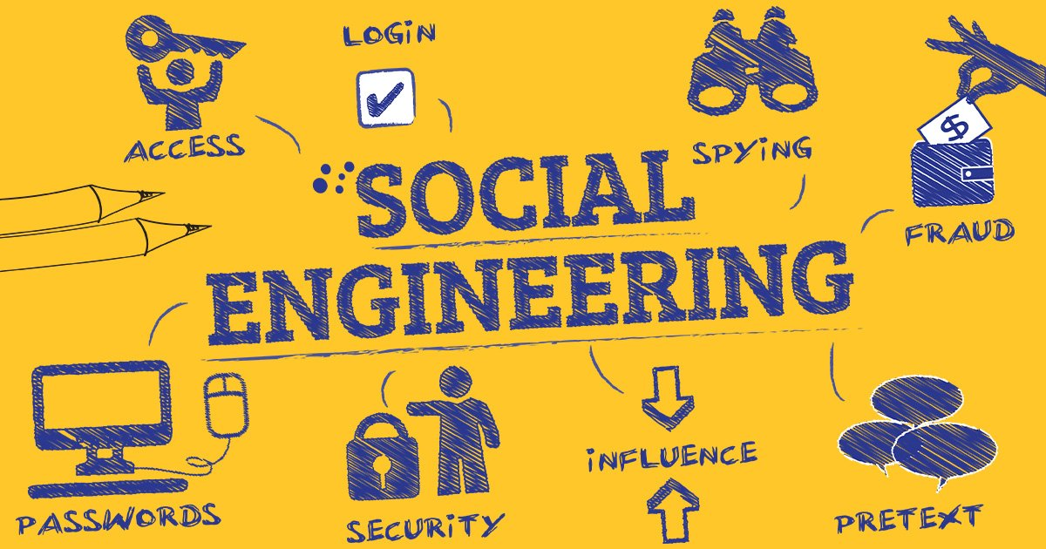
What is Social Engineering?
BY : BILAL AHMED , HAMMAD AFZAL , ABDUL HASEEB , FAISAL ALI , MUHAMMAD USMAN

Slide 2
What is social engineering?
Social Engineering Attack
Social Engineering
Phases of Attack
Types of Attack
Presented by: Bilal Ahmed

Slide 3
Social engineering attack?
“A social engineering attack is a continuous process that starts with initial research, which is the starting phase, until its completion, when the social engineer ends the conversation. The conversation is a brief coverage of the four phases that the social engineer follows to perform an attack.” (Patel & R.S., 2013)

Slide 4

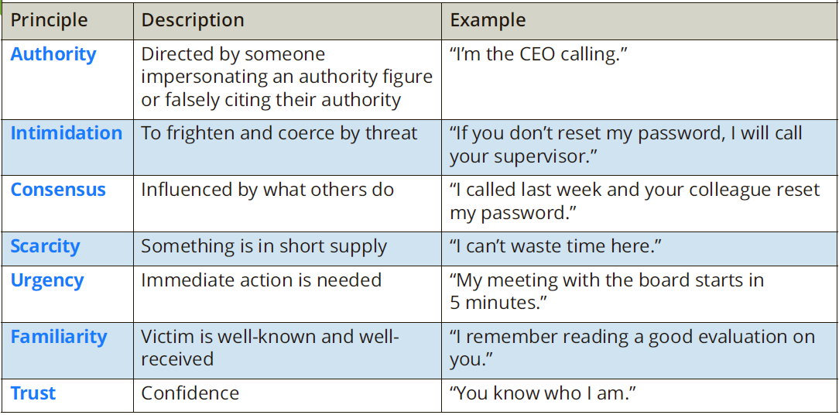
SOCIAL ENGINEERING
Technology is not always needed for attacks on IT
Social engineering gathers information by relying on the weaknesses of individuals
It relies on the psychological approaches to persuade a victim

Slide 5
Phases of attack
Basic four phases of attack

Slide 6
Phases
Research
Learn about target
Hook
○ Initial conversation/Build Trust
Play
Get Information
Exit
○ Leave without raising suspicion

Slide 7
Types of attack
HUMAN BASED
● Piggybacking
● Impersonating
● Eavesdropping
● Reverse social engineering
● Dumpster diving
● Posing as a legitimate user
COMPUTER BASED
● Pop-up windows
● Insider attack
● Phishing
● Nigerian 419 scam
● Fake SMS

Slide 8
Current Events
2019 Toyota BEC Scam
● Attacker manipulated finance/accounting departments
● Posed as a business partner
● Stole $37 million dollars
2011 RSA Phishing Scam
● Employee clicked attachment in an email
● Ran an exploit through Adobe Flash
● Attacker stole sensitive information

Slide 9
Types of Social Engineering Attacks
Phishing & Spear Phishing
Vishing & Smishing
Pretexting & Baiting
Physical Attacks
Presented by: Muhammad Afzal

Slide 10
Phishing & Spear Phishing
Email-based attacks
Fraudulent emails sent to trick users into trusting the sender
Fake links and login pages
Links redirect to look-alike websites that steal usernames and passwords
Targeted vs General Attacks
Phishing: Sent to many people at once
Spear Phishing: Carefully targeted at a specific person or organization
Whaling: Targets high-level executives with personalized messages to steal sensitive information.

Slide 11
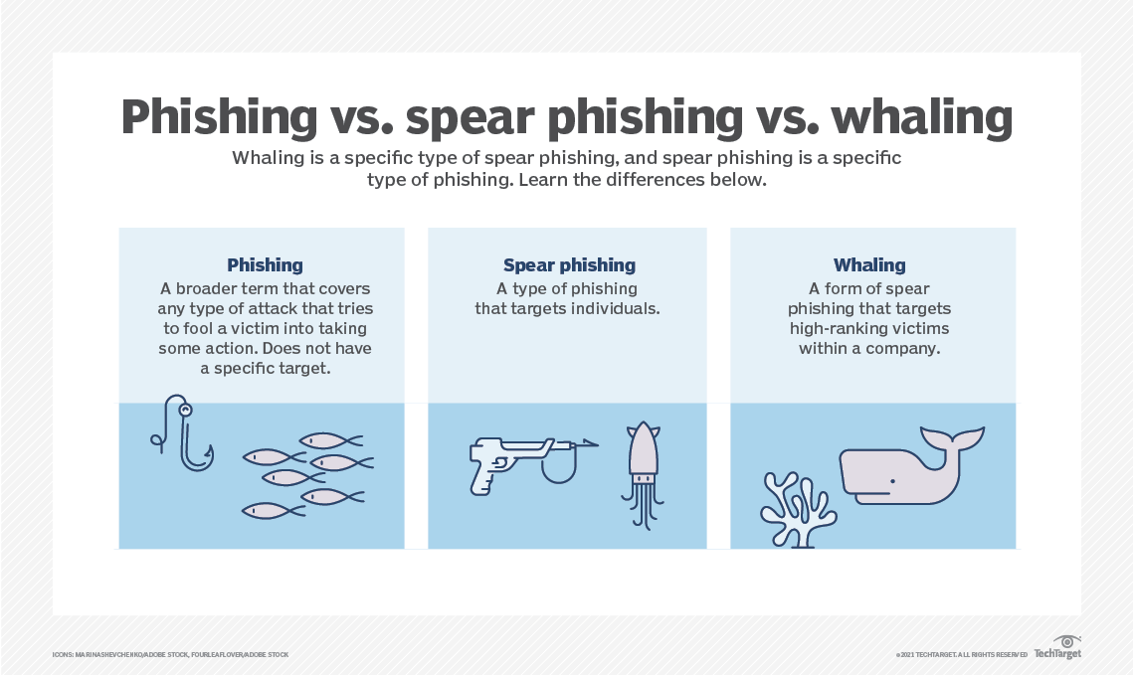

Slide 12
Vishing & Smishing
Vishing – Fraudulent voice calls pretending to be banks, authorities, or companies to steal personal information.
Smishing – SMS messages containing malicious links or requests for sensitive data.

Slide 13
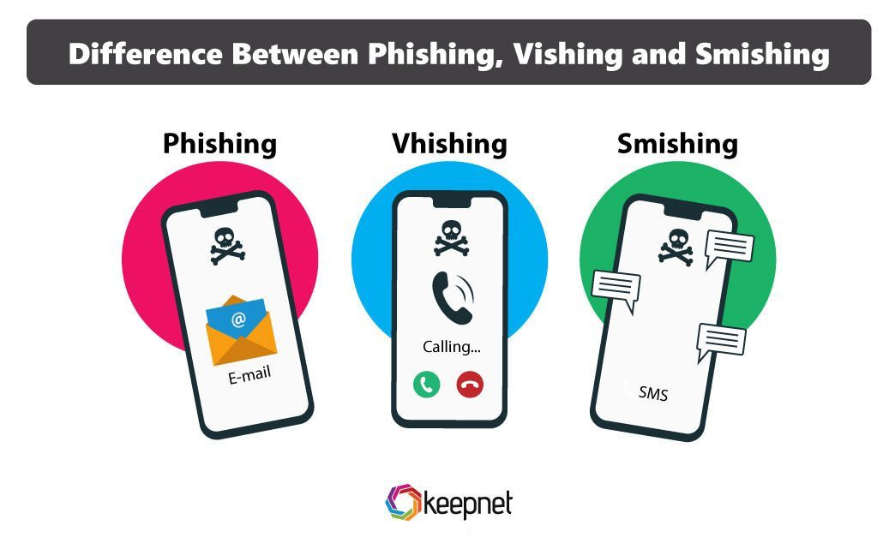

Slide 14
Pretexting & Baiting
Pretexting
Creating fake stories or scenarios to gain the victim’s trust and extract information
Baiting
Luring victims with fake rewards, free downloads, or infected USB devices

Slide 15
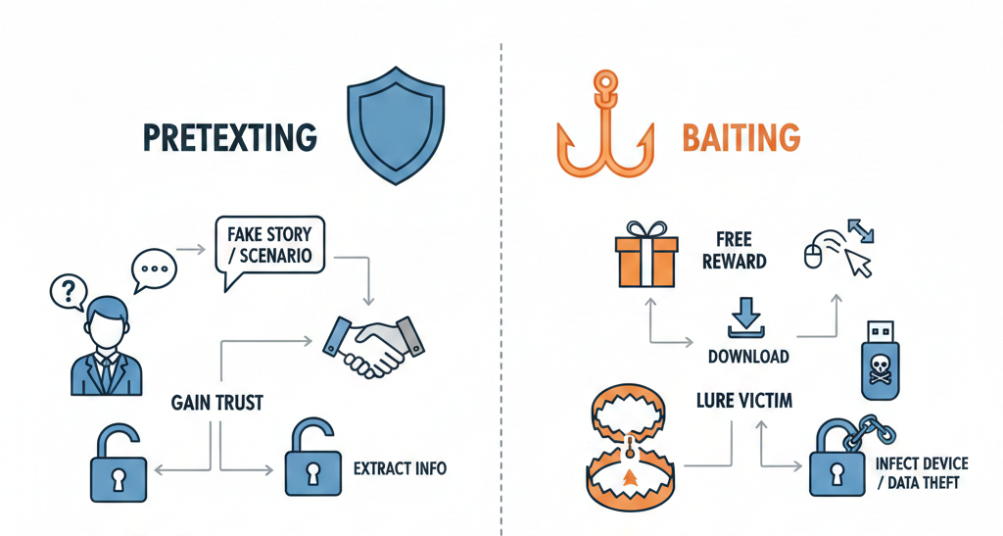

Slide 16
Physical Attacks
Tailgating
Unauthorized person follows an employee into a restricted area
Impersonation inside offices
Attacker pretends to be staff, technician, or visitor to gain access

Slide 17
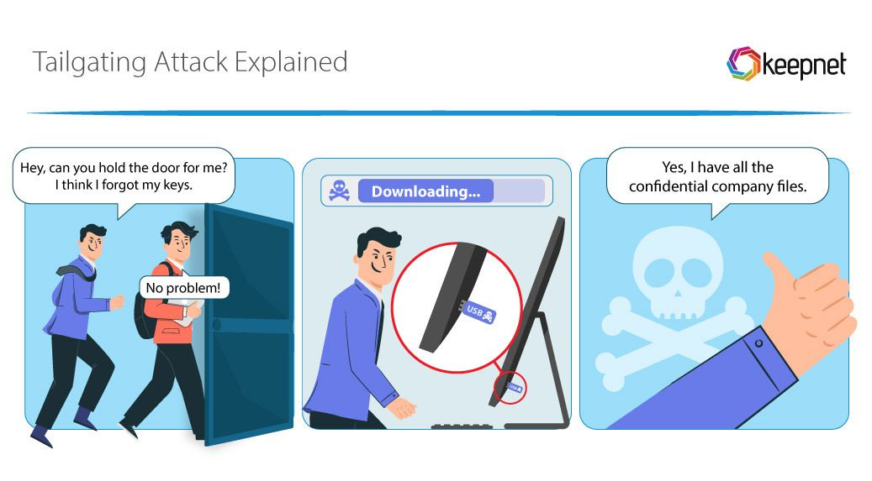

Slide 18
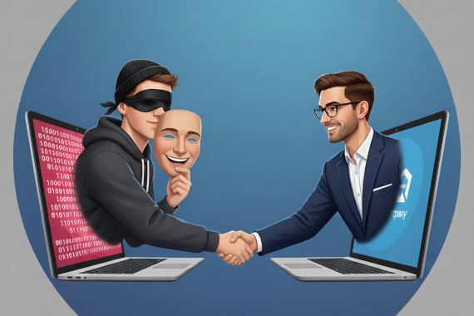

Slide 19
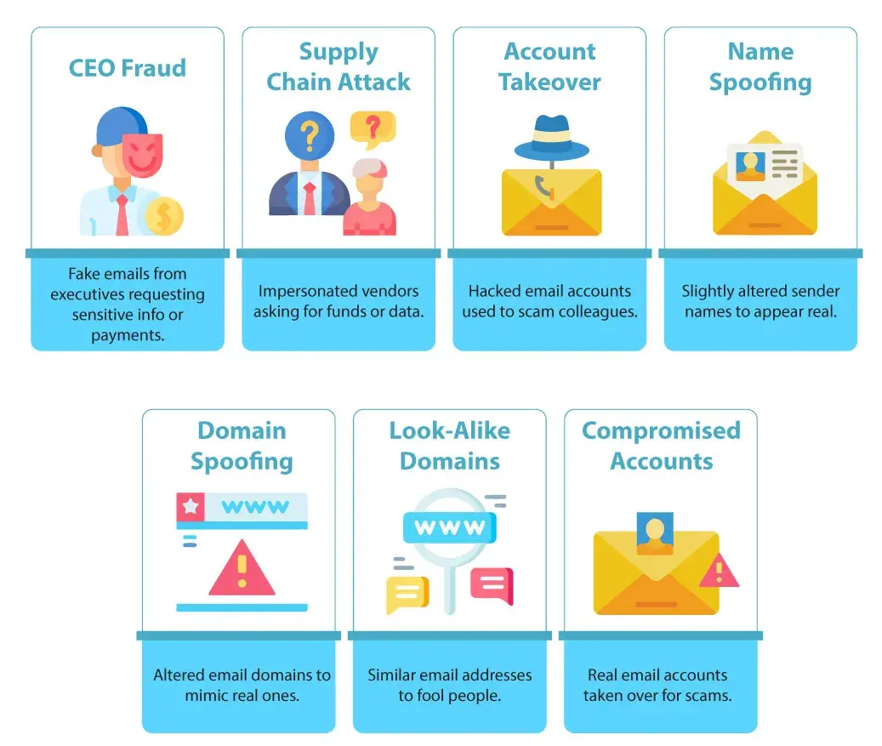

Slide 20
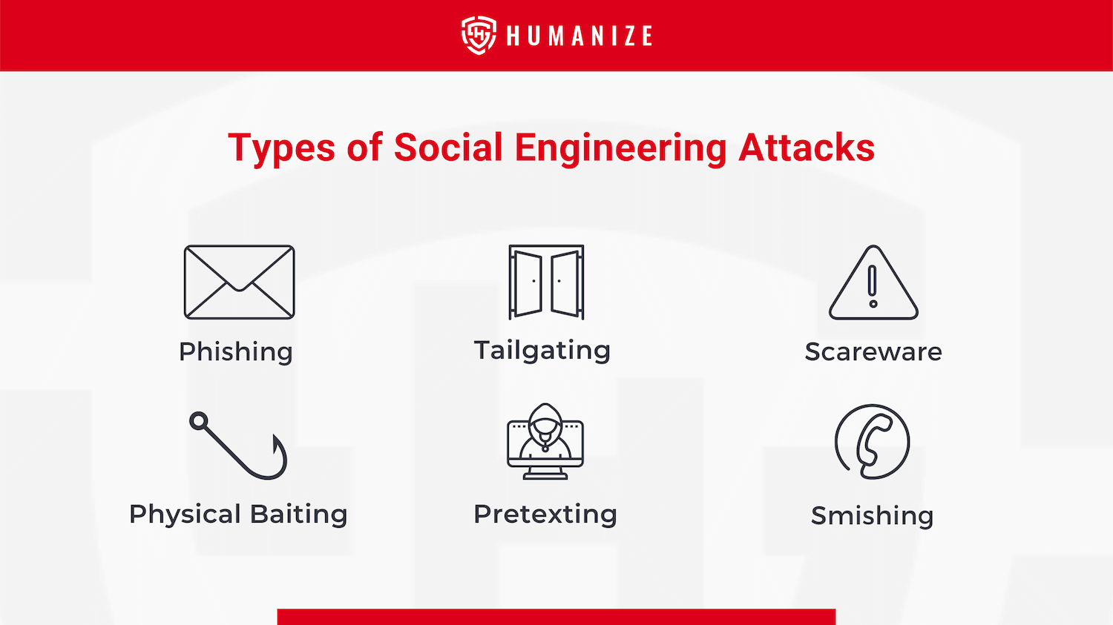

Slide 21
Phishing
Presented by: Abdul Haseeb

Slide 22
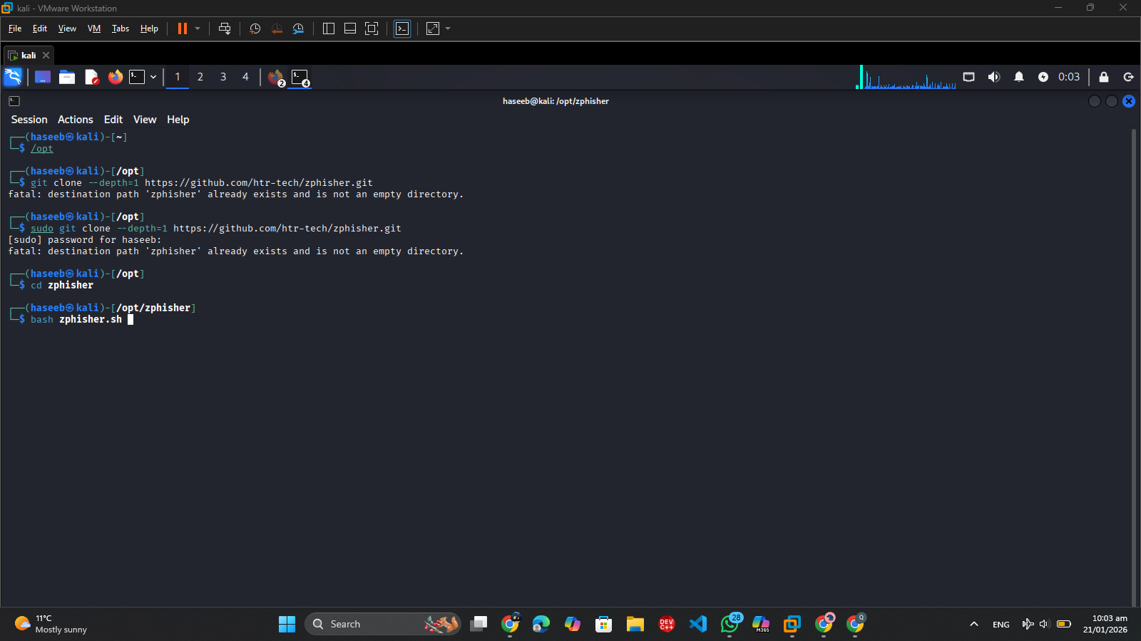

Slide 23


Slide 24
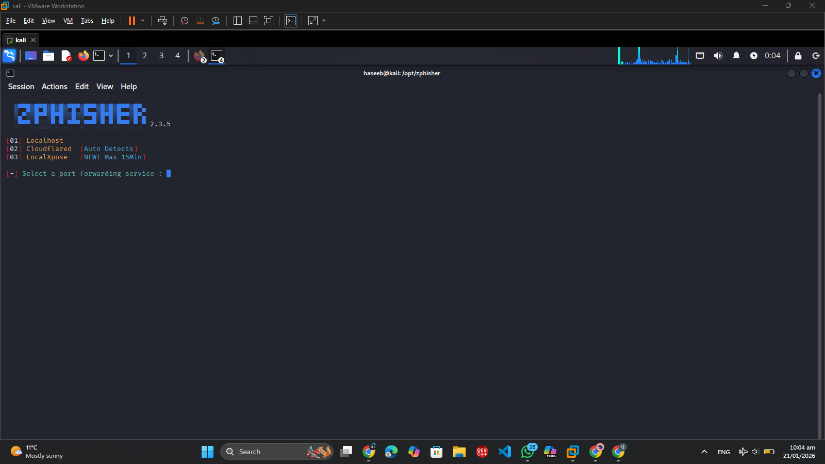

Slide 25
Real World Case Studies & Impact
Famous Social Engineering Attacks
Individual Impact
Organizational Impact
Why Attacks Succeed
Presented by: Muhammad Usman

Slide 26
famous Social Engineering Attacks
Google & Facebook Phishing Scam (2010)
In 2010, attackers targeted employees of Google and Facebook using phishing emails.
The emails pretended to be from trusted sources and tricked employees into revealing login credentials.
Using these credentials, attackers accessed company accounts and attempted financial fraud, including transferring money or stealing sensitive data.
The scam affected 100+ employees and caused losses of over $100M+.
This case is an example of how social engineering can bypass technical security by exploiting human trust.

Slide 27
Twitter Account Hijacking (2020)
30 high-profile accounts hacked – including Elon Musk, Bill Gates, and major companies.
$120,000 stolen – attackers posted cryptocurrency scam messages asking followers to send Bitcoin.
How it happened – attackers used social engineering on Twitter employees, gaining internal access to bypass security controls.
Impact – Highlighted how even major tech companies are vulnerable when human trust is exploited.

Slide 28
Impact on Individuals
Identity Theft – Personal information is stolen and misused
Financial Loss – Money lost through fraud or unauthorized transactions
Privacy Breach – Sensitive data exposed without consent
Example:
A person receives an email claiming to be from their bank asking to “verify account details.” They enter their username and password on a fake website. The attacker then:
Steals their identity (personal info like CNIC, phone number)
Transfers money from their bank account (financial loss)
Accesses private emails and files (privacy breach)

Slide 29
Organizational Impact
Data Leaks – Sensitive customer or company data can be stolen, exposing private information.
In 2013, Target suffered a data breach exposing 110 million customers’ personal and credit card information.
Reputation Damage – Trust in the company decreases, affecting clients, partners, and investors.
After the Equifax breach (2017), the company’s stock dropped ~35% and public trust plummeted.
Legal Consequences – Organizations may face fines or lawsuits for failing to protect data.
Companies like Yahoo faced fines of $35 million due to inadequate protection of user data.

Slide 30
Why Attacks Succeed
Lack of Awareness – Many people don’t recognize phishing emails or suspicious requests.
Trust in Authority – Attackers exploit respect for bosses, IT staff, or official organizations.
Reputation Damage – Trust in the company decreases, affecting clients, partners, and investors. Poor Security Practices – Weak passwords, shared credentials, or unverified links make attacks easier.
91% of breaches start with phishing (Verizon DBIR 2021).
95% of cybersecurity incidents involve human error (IBM 2020).

Slide 31
Prevention, Detection & Conclusion
How to Identify Social Engineering
Prevention Techniques
Organizational Security Measures
Conclusion & Key Takeaways
Presented by: Faisal Ali

Slide 32
How to Identify Social Engineering
Suspicious Links – Hover over links to check URLs; avoid clicking unknown or shortened links.
Urgent Messages – Be cautious of messages creating panic or pressure to act immediately.
Unknown Senders – Verify emails or calls from unfamiliar contacts before sharing information.
90% of attacks show clear warning signs like suspicious links or urgent requests (Proofpoint 2022).

Slide 33
Prevention Techniques
Strong Passwords – Using complex passwords reduces account compromise risk by 80–90%.
Two-Factor Authentication (2FA) – Protects accounts; reduces phishing success by 99.9% (Microsoft 2019)
Security Awareness Training – Employees trained on phishing are 70% less likely to fall for scams (KnowBe4 2021).
Regular Software Updates – Prevent attackers from exploiting vulnerabilities; 60% of breaches exploit unpatched software.

Slide 34
Organizational Security Measures
Email Filtering – Blocks over 80% of phishing emails before reaching employees (Mimecast 2022).
Security Policies – Companies with strict policies experience 50% fewer successful attacks (ISACA 2021).
Regular Audits – Detect 40–50% of potential breaches early, preventing major data loss.

Slide 35
Conclusion & Key Takeaways
Humans are the weakest link – 91% of cyberattacks start with social engineering (Verizon 2021).
Awareness is the best defense – Security training reduces phishing susceptibility by 70% (KnowBe4 2021).
Think before you click – Over 3.4 million phishing emails are sent daily; caution prevents costly breaches.

